Slide 1



Crafting Compiling web preferences
By V. Anusha Raghavan

Slide 2
Top five products descriptions of HCL
Task 1

Slide 3
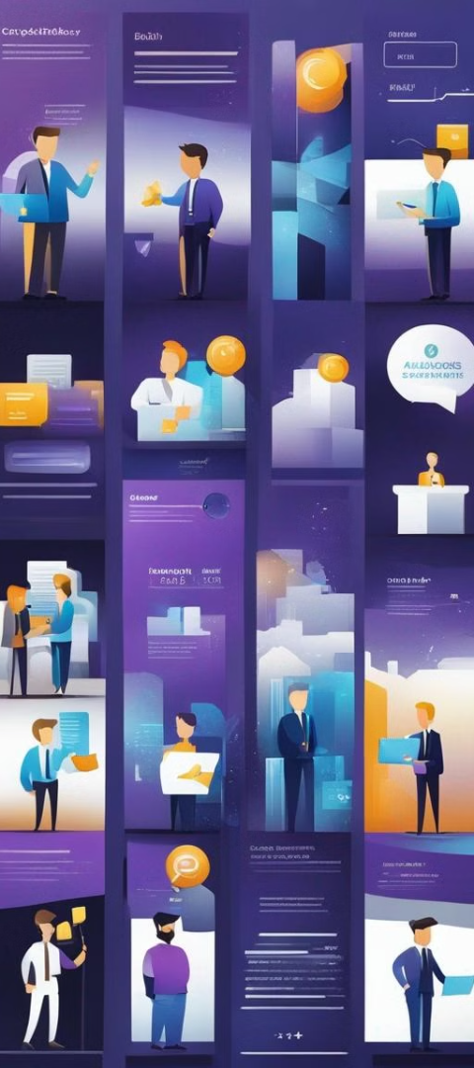
Here are the top 5 product descriptions of HCL
1
HCL Notes:
Formerly known as IBM Notes, HCL Notes is a collaborative client-server software platform used for messaging and application development. It provides email, calendar, contact management, and integrated instant messaging functionalities, along with the ability to develop custom applications.il
2
HCL Domino:
Formerly IBM Domino, HCL Domino is a server software platform that enables businesses to create, deploy, and manage business-critical applications. It offers features for collaboration, workflow automation, and data storage, facilitating the development of scalable and secure enterprise applications.
3
HCL Commerce:
Formerly IBM Commerce, HCL Commerce is an enterprise-grade e-commerce platform designed to help businesses create personalized, omnichannel shopping experiences. It provides features for catalog management, merchandising, marketing, and order management, empowering organizations to drive sales and customer engagement across digital channels.

Slide 4
Here are the top 5 product descriptions of HCL – contd.
4
HCL Leap:
HCL Leap is a digital experience platform that enables organizations to rapidly build, deploy, and manage digital solutions and applications. It offers tools for low-code development, content management, and process automation, empowering businesses to innovate and adapt to changing market demands quickly.
5
HCL BigFix:
HCL BigFix is an endpoint management and security solution that helps organizations manage and secure their endpoints across diverse operating systems and devices. It provides capabilities for patch management, software distribution, compliance monitoring, and threat detection, helping businesses maintain the security and integrity of their IT infrastructure.

Slide 5
To determine on which the platform is developed
Task 2

Slide 6

https://www.hcl-software.com/ the website is developed on the following
1
CONTENT MANAGEMENT SYSTEM(CMS)
2
PROGRAMMING LANGUAGES
HCL digital experience
Drupal
WordPress
PHP
Java
3
ANALYTICS
4
DATABASES
Piwik PRO Core
LinkedIn Insight share
Google Analytics
Facebook Pixel
Crazy Egg
MySQL
5
ADVERTISING
Twitter Ads

Slide 7
https://www.hcl-software.com/ the website is developed on the following
6
JAVA SCRIPT LIBRARIES
9
BLOGS
jQuery- UI
Core-js
Owl Carousel
J-Query
Fancy Box
WordPress
10
SECURITY
HSTS
7
TAG MANAGERS
11
COOKIE COMPLIANCE
Google Tag manager
One Trust
8
UI Framework
12
MISCELLANEOUS
Bootstrap
Open Graph
Popper

Slide 8
"Website Responsive Design & Mobile Optimization Test Report"
Task 3

Slide 9

Website's responsive design
and mobile optimization test report
Page 1: https://www.hcl-software.com/
1
Report Link: https://search.google.com/test/mobile-friendly/result?id=kB7Eyvy5Do3Wau6WBvArOg
Page 2: https://www.hcl-software.com/notes
2
Report Link: https://search.google.com/test/mobile-friendly/result?id=jeLRk1Vigg2T5NOhzwjZHw
Page 3: https://www.hcl-software.com/domino
3
Report Link: https://search.google.com/test/mobile-friendly/result?id=UTmKfTW5LPXfVXvStze7oQ

Slide 10
Website's responsive design and
mobile optimization test report (contd.)
Page 4: https://www.hcl-software.com/commerce
4
Report Link: https://search.google.com/test/mobile-friendly/result?id=MahoIYK6fMpuZYUem45MgA
Page 5: https://www.hcl-software.com/leap
5
Report Link: https://search.google.com/test/mobile-friendly/result?id=Xt-MKcVH-HYIFdGIWlOkYw
Page 6: https://www.hcl-software.com/bigfix
6
Report Link: https://search.google.com/test/mobile-friendly/result?id=tayBLQYJ6ED1nPq6fxJyfw

Slide 11
"Website Responsive Design & Mobile Optimization Test Report"
Task 4

Slide 12

Major Design Mistakes to Keep Clear Of! with suggestions
Cluttered Layouts
Poor Navigation:
Having too much content or too many elements on a webpage can overwhelm visitors and make it difficult for them to find what they're looking for.
Suggestions: Aim for clean, organized layouts with ample whitespace to improve readability and usability.
Complex or unclear navigation menus can confuse users and lead to frustration.
Suggestions: Make sure your website has intuitive navigation with clear menu labels and logical hierarchy to help users easily find their way around.

Slide 13
Major Design Mistakes to Keep Clear Of!
with suggestions (contd.)
Overuse of Pop-Ups:
Lack of Mobile Optimization:
Excessive use of pop-ups, especially those that interrupt the user's browsing experience, can be annoying and disruptive.
Suggestions: Use pop-ups sparingly and ensure they provide value to the user, such as offering relevant information or promotions.
With the increasing use of mobile devices for browsing the web, it's crucial to ensure your website is optimized for mobile users.
Suggestions: Avoid fixed-width layouts and use responsive design techniques to ensure your site looks and functions well on all screen sizes..

Slide 14
Major Design Mistakes to Keep Clear Of!
with suggestions (contd.)
Inconsistent Branding:
Ignoring User Feedback:
Inconsistent branding elements such as colors, fonts, and imagery can confuse users and dilute your brand identity.
Suggestions: Maintain a cohesive design across all pages of your website to reinforce your brand and create a memorable user experience. Around.
Failing to listen to user feedback and analytics data can result in missed opportunities for improvement.
Suggestions: Regularly gather feedback from users and analyze website metrics to identify areas for enhancement and optimization.

Slide 15
List of best practices for creating visually appealing and user-friendly website designs.
Task 5

Slide 16
Best practices for creating visually appealing and user-friendly website designs.
Clear and Intuitive Navigation
Consistent Branding
Mobile Responsiveness
Whitespace
Hierarchy of Information
Visual Consistency
Cross-Browser Compatibility
User-Centric Design
High-Quality Images and Graphics
Optimized Loading Time
Accessibility
Clear Call-to-Action (CTA)
User Feedback
Cross-Browser Compatibility
Performance Optimization

Slide 17
Landing page for product or service to generate leads.
Task 6
https://www.figma.com/file/xOfUZVm9jEwasPn1eoPT7g/HCL_MockUp_1?type=design&node-id=5%3A2&mode=design&t=BV8MMa3cDqogN1oY-1
THANK YOU

